Slide 1
Decision Tree Regression

Slide 2
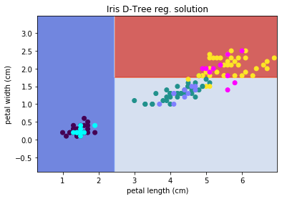
DT Regression
Classification
Create clean splits
Notes:
Photo: https://www.flickr.com/photos/107442568@N08/12547327134

Slide 3
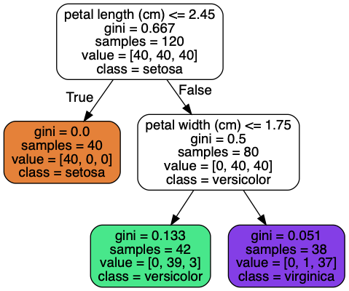
DT Regression
Classification
Create clean splits
Notes:
Photo: https://www.flickr.com/photos/107442568@N08/12547327134

Slide 4
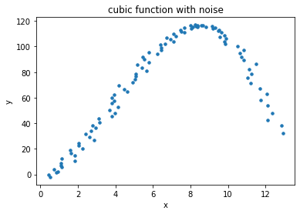
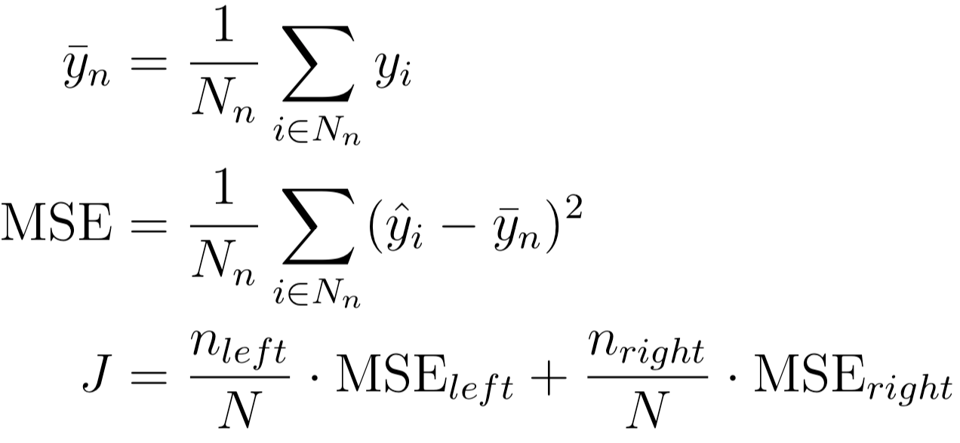
DT Regression
Regression
Split to minimize MSE
For each node, n
Notes:
Photo: https://www.flickr.com/photos/107442568@N08/12547327134

Slide 5
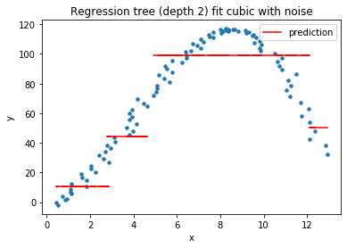
DT Regression
Regression
Split to minimize MSE
For each node, n
Notes:
Photo: https://www.flickr.com/photos/107442568@N08/12547327134

Slide 6
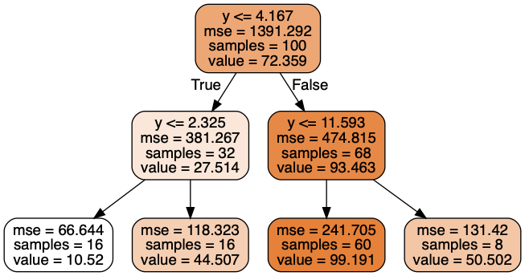
DT Regression
Regression
Split to minimize MSE
For each node, n
Notes:
Photo: https://www.flickr.com/photos/107442568@N08/12547327134

Slide 7
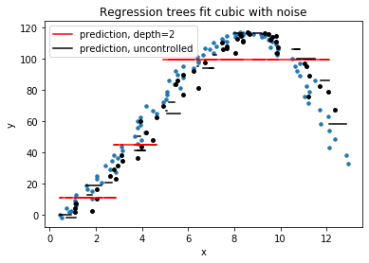
DT Regression
Still prone to overfitting when left to grow uncontrolled
Notes:
Photo: https://www.flickr.com/photos/107442568@N08/12547327134

